Slide 1

INVESTIGATION OF THE FLOW DYNAMICS OF A VERTICAL BIOREACTOR USING THE RESIDENCE TIME DISTRIBUTION
By: Mark Edney,
Beng, eit, masc. candidate

Slide 2
Table of Contents
Water Engineering
Conventional Bioreactor
Vertical Bioreactors
Experimental Setup
Instrumentation
Concentration Curve
Probability Density Function
Moments of a Distribution
Reactor Models
Model Testing Results
Distribution Function
Holdback and Segregation
Dead space and by-passing
Conclusions
Acknowledgements

Slide 3
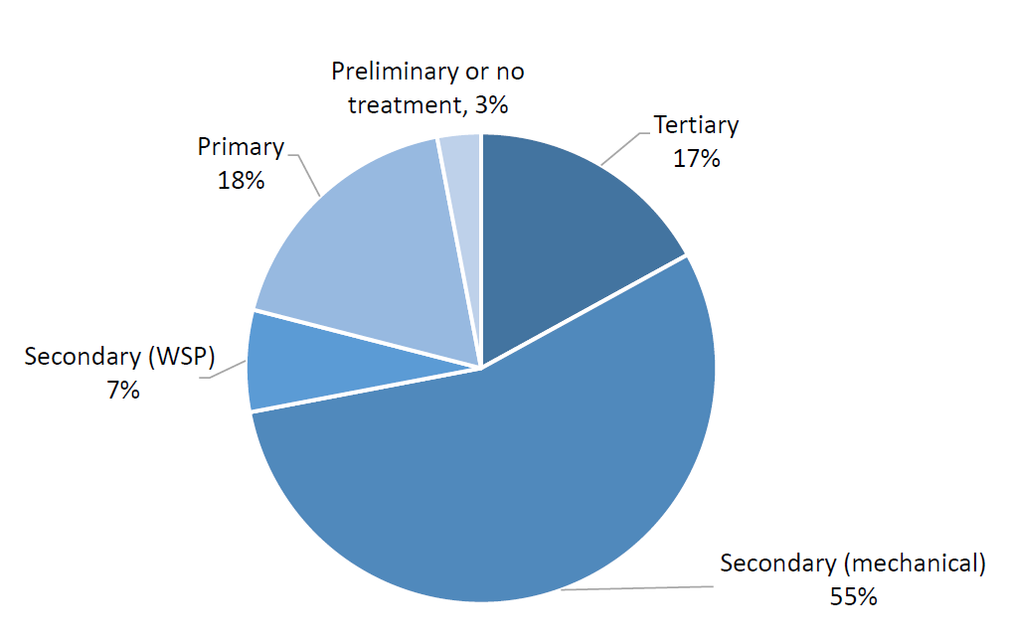
Water Engineering
The release of nutrients are well documented to cause:
Anoxia
Harm to aquatic life
Eutrophication
Decrease chlorine disinfection
Regulations in Canada have been slow
Very little of the wastewater in Canada receives nutrient removal
Estimated that 1 in 4 facilities will need to be upgraded
Levels of wastewater treatment across Canada [1]

Slide 4
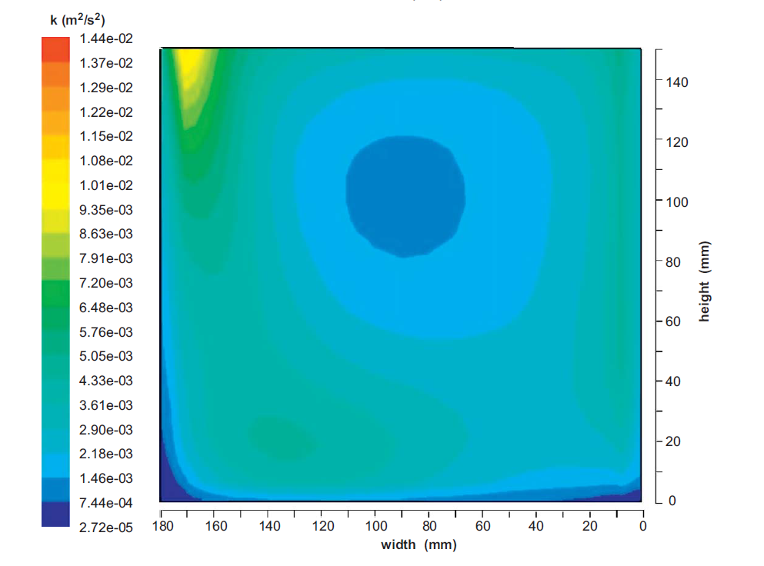
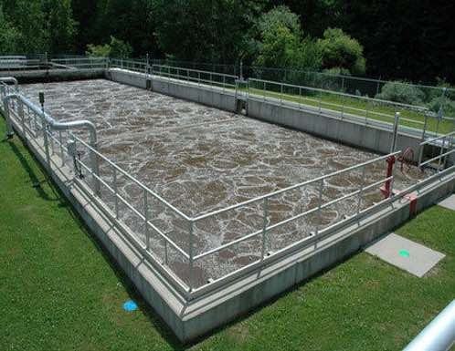
Conventional Bioreactor
Large, expensive concrete structures
Poor mixing
High consumption of energy
Difficult to upgrade
CAS bioreactor[3]
CFD of a rectangular reactor [2]

Slide 5
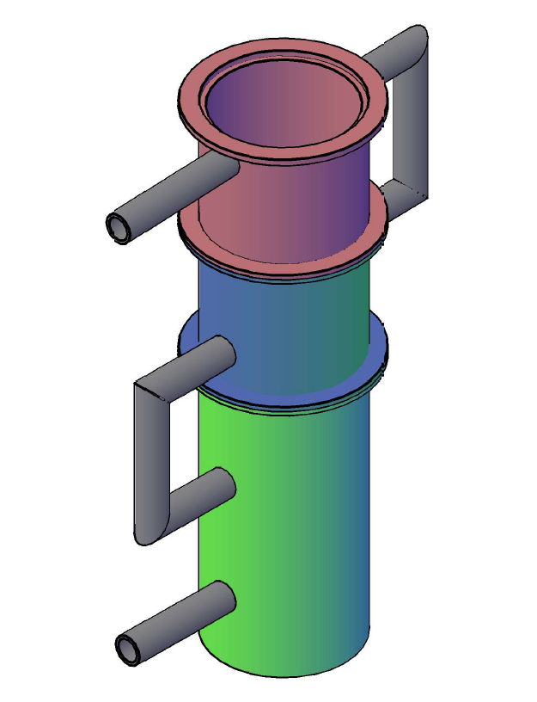
Vertical Bioreactors
The STAR vertical bioreactor has three distinct stages
Vertical orientation
Small footprint
Gravity assisted flow
Modular configuration
Cheap and strong material (PVC/fiberglass)
Developed by Dr. Reza and Dr. Alvarez Cuenca
Thesis: To study the flow dynamics of a vertical bioreactor with
the residence time distribution technique

Slide 6
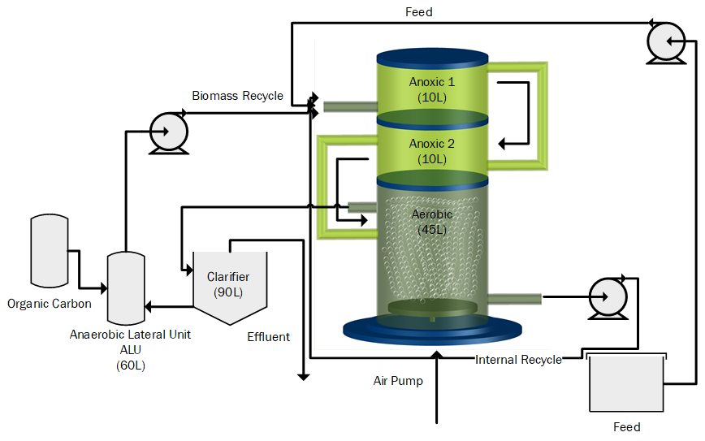
Experimental Setup
Includes two recycle streams
Operated with tap water
Conductive tracer of NaCl
Tracer injected in feed stream
Stream | Flow Rate (L/hr)
Feed | 10
Internal Recycle | 20
Recycle Sludge | 15
STAR Reactor Process Flow [4]

Slide 7
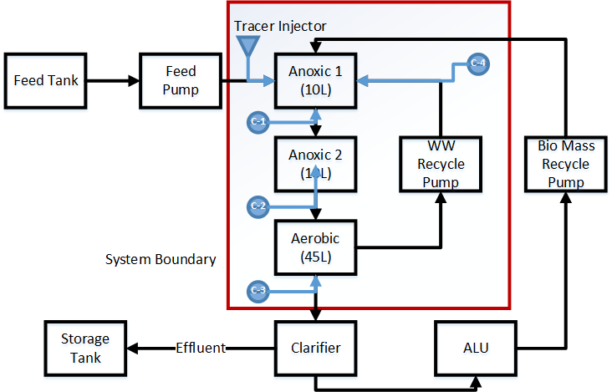
Instrumentation
4 Conductivity sensors were used
Exit of each stage
50 ml of 5g/L of NaCl
Sensors attached to DAS
DAS connected to PC with Labview

Slide 8
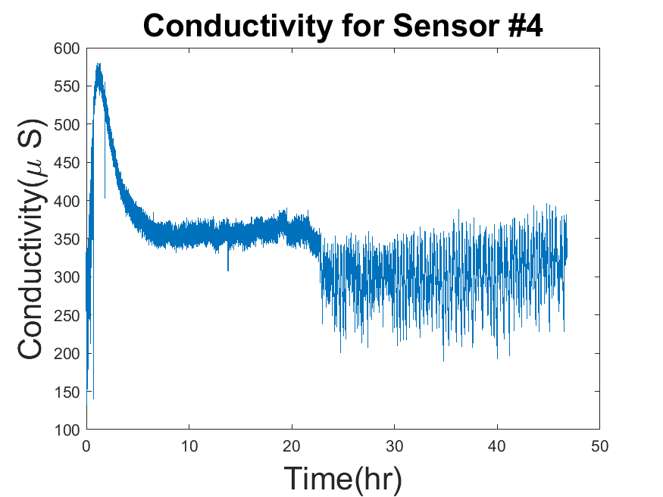
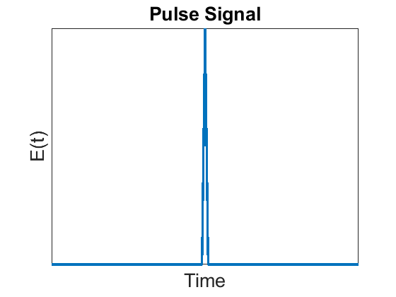
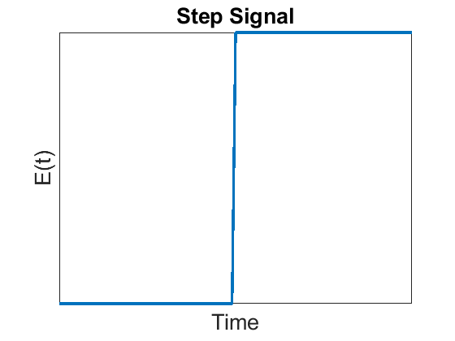
Concentration Curve C (t)
Technique to study mixing behaviour
First introduced by Dankwerts in 1952
Conductivity was found as a linear function
of concentration
A pulse signal was used

Slide 9
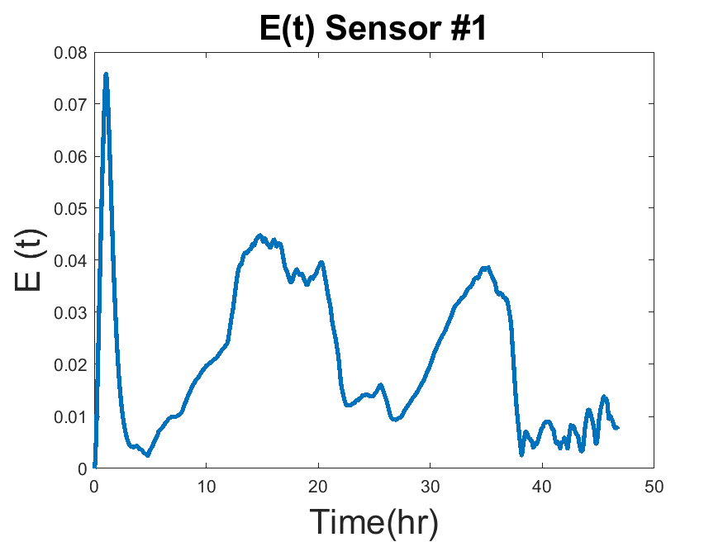

Probability Density Function E (t)
Probability of a tracer element exiting at time t
Numerical integration
Pulse response
$$E(t)=\frac{\left.C(t\right)}{\int_{0}^{∞}{C\left(t\right)dt}}$$

Slide 10
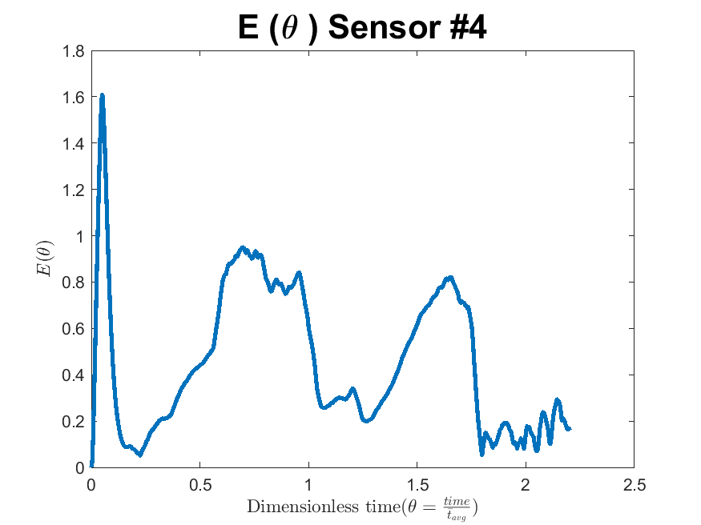




Moments of a Distribution
Describe distributions
1st
2nd
Conversion to dimensionless time
$$\overline{t}=\int_{0}^{∞}{tE\left(t\right)dt}$$
$σ^{2}=\int_{0}^{∞}{{\left[\overline{f}−f\left(t\right)\right]}^{2}E\left(t\right)dt}$
$θ=\frac{t}{\overline{t}}$
$$E\left(θ\right)=E\left(t\right)×\overline{t}$$

Slide 11

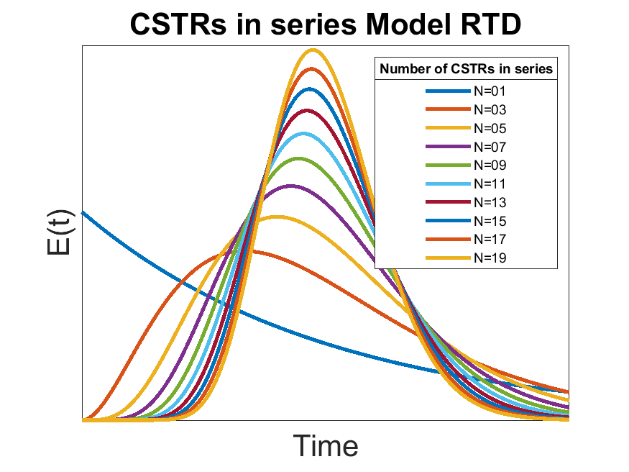
Reactor Models
Model is proposed
The model is solved for a non-reactive tracer
E (t) is then derived by definition
E (t) or E (θ) compared to experimental RTD
Ideal CSTR and PFR were compared
Real reactor models are deviations from ideal
Ex. CSTRS in series
From CSTR to PFR as n->∞

Slide 12
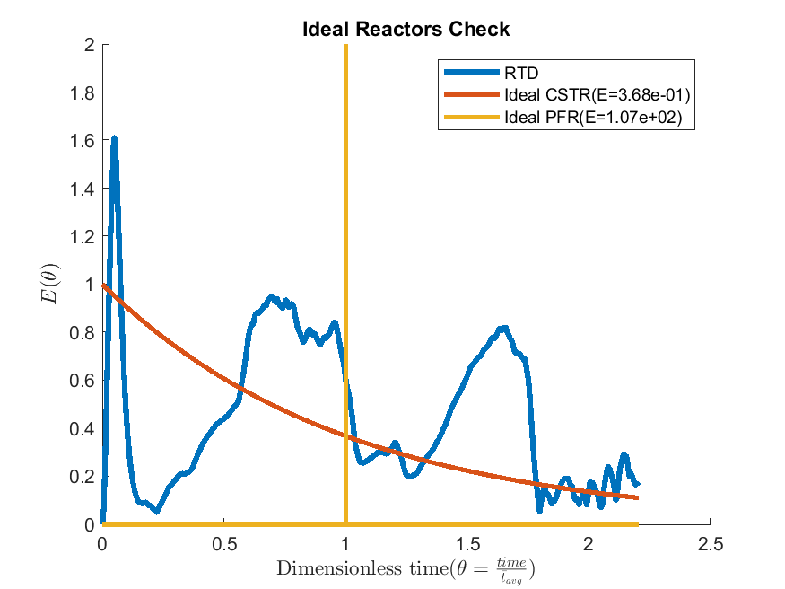
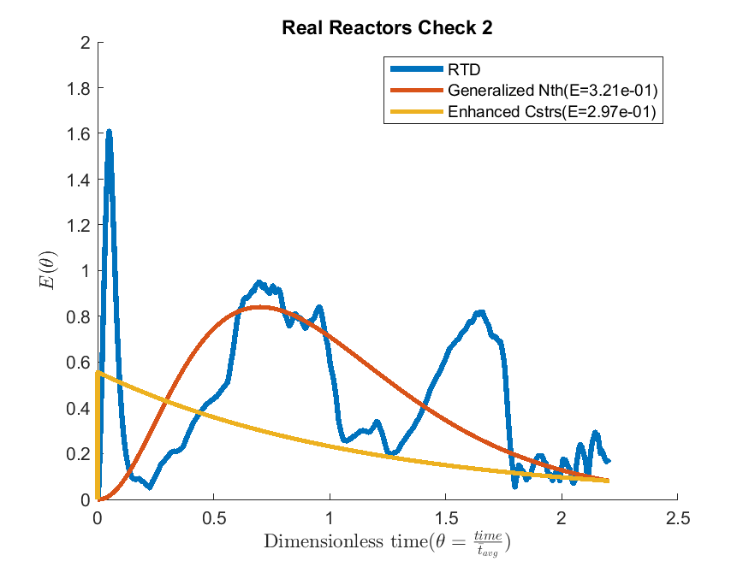
Model Testing Results

Slide 13
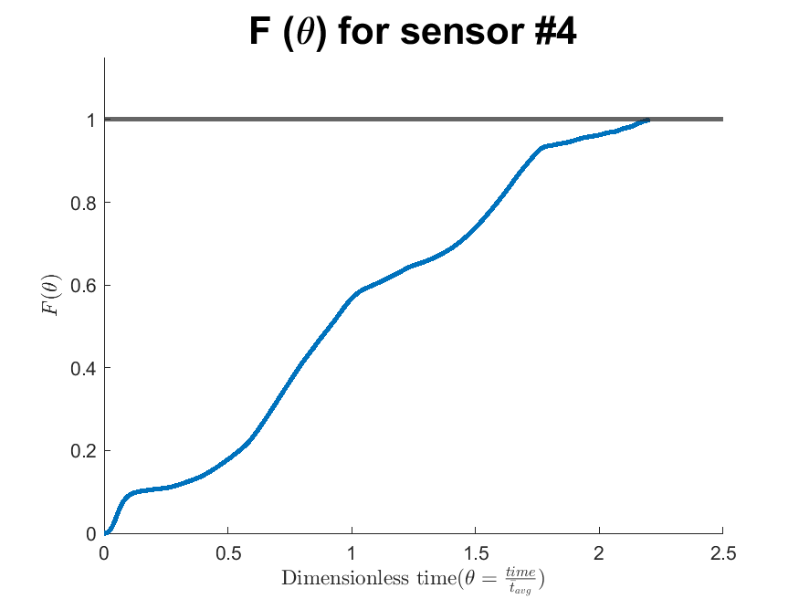


Distribution Function F (t)
Cumulative sum of tracer exiting reactor
Can be expressed as F (t) or F (θ)
Step-response
Calculate Holdback (H)
Calculate Segregation (S)
Deviation from CSTR F (θ)= 1-e^{-θ}
$$F(t)=\int_{0}^{t}{E\left(t\right)dt}$$
$$H=\int_{θ=0}^{θ=1}{F\left(θ\right)dθ}$$

Slide 14
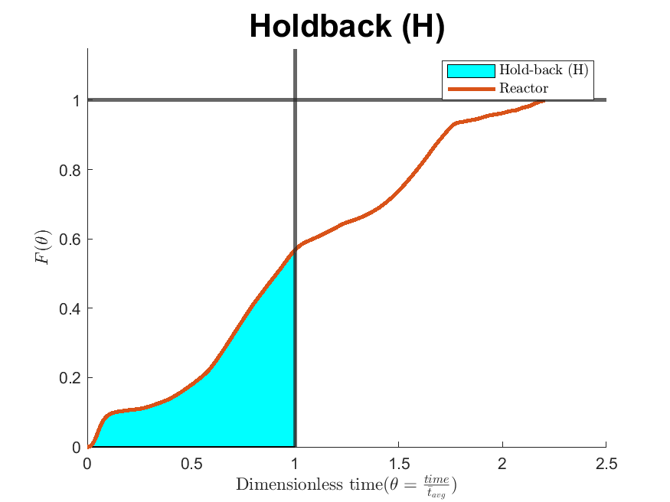
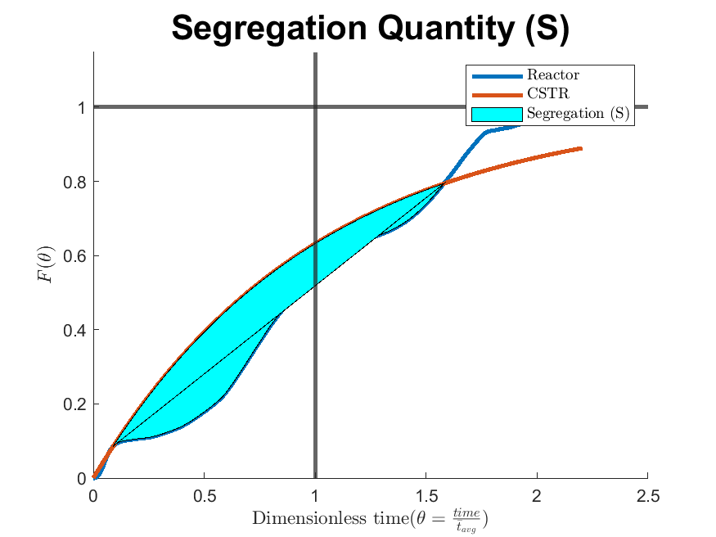
Holdback (H) and Segregation (S)
H= 0.2365 S= -0.1639
Ideal CSTR H= e⁻¹ ( ≈ 0.3679) S=0

Slide 15
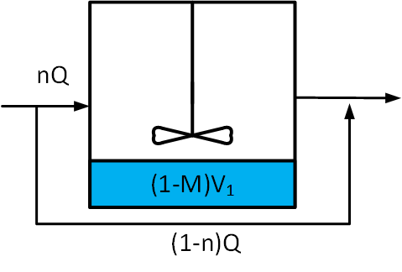


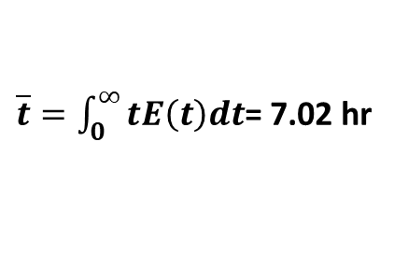
Dead space and By-passing
${\overline{t}}_{Dead Space}<τ<{\overline{t}}_{By−pass}$
For a trial with internal recycle pump turned off
7.5% by-passing
$τ=\frac{V_{1}+V_{2}+V_{3}}{v_{1}}=\frac{10L+10L+45L}{10L/h}$= 6.5hr
$\overline{t}=\int_{0}^{∞}{tE\left(t\right)dt}$= 7.02 hr

Slide 16
Conclusions
The RTD curves for the STAR vertical bioreactor were found
Ideal CSTR and generalized CSTR in series were found to be good fits
A high level of mixing was found with a low Segregation value of -0.16
Future Work
Union with kinetic models (ex. ASM2D)
Optimized the MRT by controlling the internal recycle rate
Create a CFD model
Expansion of unit capacity

Slide 17
Acknowledgments
Under the supervision of
Dr. Manuel Alvarez Cuenca
Dr. Maryam Reza
Dr. Simant Upreti
Examining Committee
Ryerson Chemical Engineering Department
Ryerson Chemical Engineering Support Staff

Slide 18
References
D. Mavinic et al., “Canads’s challenges and opportunities to address contaminants in wastewater,” Canadian Water Network, March 2018, Mar. 2018. Accessed: Aug. 19, 2020. [Online]. Available: https://cwn-rce.ca/wp-content/uploads/2018/08/CWN-2018-Expert-Panel-Report-on-Contaminants-in-Wastewater.pdf.
Y. Le Moullec, C. Gentric, O. Potier, and J. P. Leclerc, “CFD simulation of the hydrodynamics and reactions in an activated sludge channel reactor of wastewater treatment,” Chemical Engineering Science, vol. 65, no. 1, pp. 492–498, Jan. 2010, doi: 10.1016/j.ces.2009.03.021.
H. Jamal, “Activated Sludge Process Activated Sludge Wastewater Treatment Mechanism and Procedure.” https://www.aboutcivil.org/activated-sludge-process-system-for-wastewater-treatment.html (accessed Sep. 02, 2020).
M. Alvarez Cuenca and M. Reza, “The multi-stage vertical bioreactor in water engineering,” The Canadian Journal of Chemical Engineering, vol. 98, no. 1, pp. 172–185, 2020, doi: 10.1002/cjce.23621.

